Slide 1
Overview of Industry and
NTE Value Propositions
Animal Welfare Update

Slide 2
Nova Tech Purpose Statement
We create revolutionary solutions that advance our customer’s ability to feed the world.

Slide 3
Beak Treatment
Let’s Start with Why

Slide 4
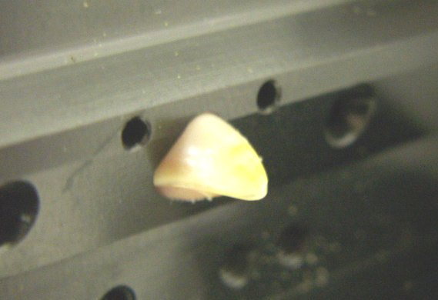
Infrared Beak Treatment (IRBT)

Slide 5
Goals of Beak Treatment
When properly administered beak treatment helps to:
  Control of pecking related injuries and cannibalism.
  Improve feather scores / bird temperature regulation.
  Improve feed conversion ratio
  Promote bird development, weights and flock uniformity.
  Improve feed intake.
    Key for sustaining peak egg production in high performing layer strains.
The above helps to maximize the genetic potential of poultry species

Slide 6
Other Benefits of infrared beak treatment
Non contact bloodless procedure.
Improve bio-security. Administered in bio-secure hatchery versus traveling teams to the farms.
Adjustable / prescriptive treatment. Able to match treatment against flock age, breed and farm conditions.
UK research suggest that IR beak treatment of day old chicks does not result in chronic adverse consequences for sensory function, nor does it demonstrate evidence of chronic pain associated with the procedure.
2
2 Chronic neurophysiological and anatomical changes associated with infra-red beak treatment University of Glasgow, Dr Dorothy McKeegan, Dr Adrian Philbey

Slide 7
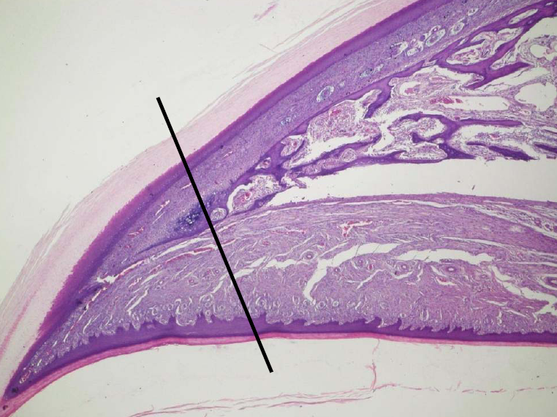
Beak portion exposed to treatment source

Slide 8
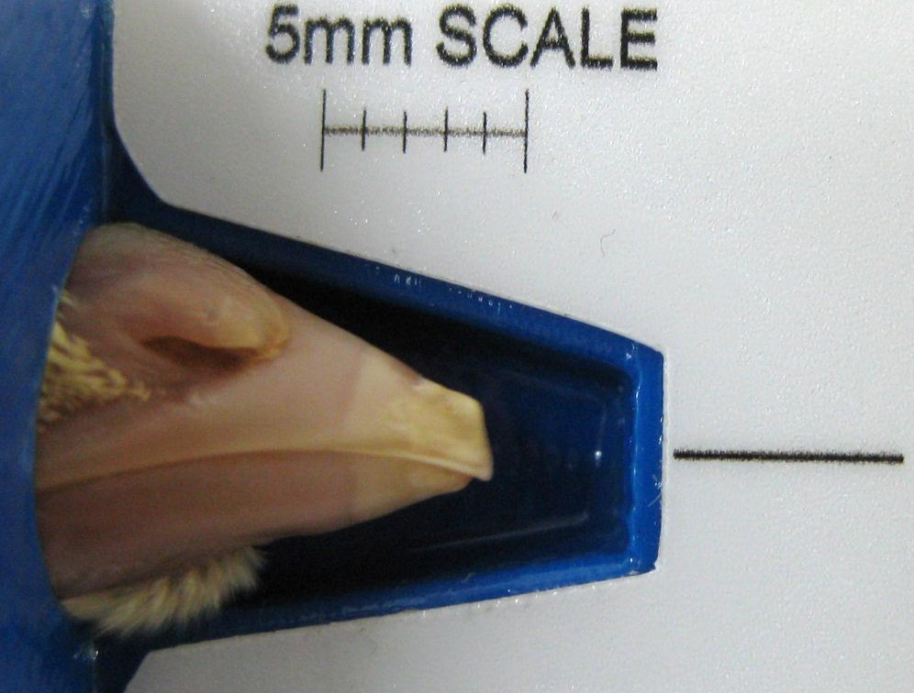
Infrared Treatment
1 Day After
Beak tissue affected by infrared energy

Slide 9
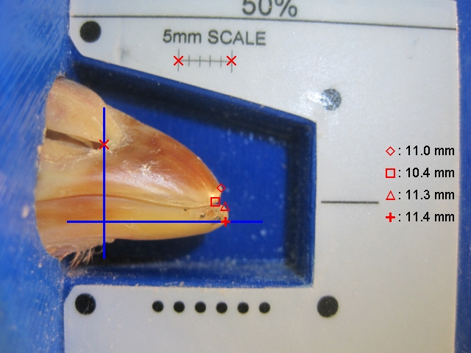
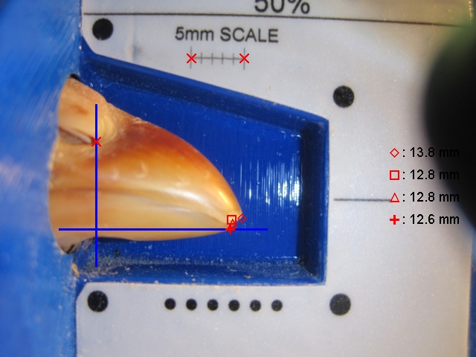
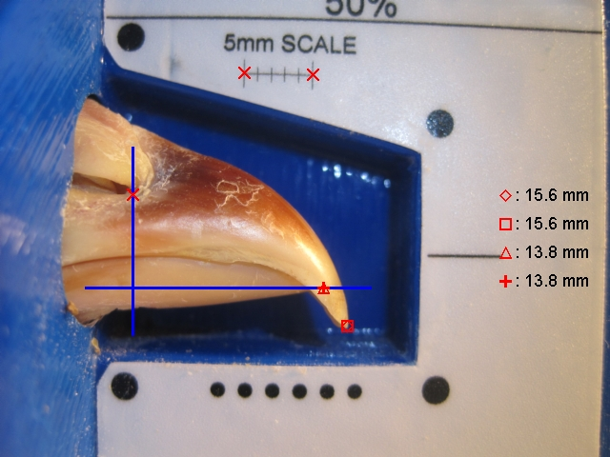
Examples of Prescriptive Treatment
@84 Days
25/23 Plate
30% of Beak Length Reduction
27/23c Plate
15% Beak Length Reduction
No Treatment
100% of Beak Length

Slide 10
Economic Impact of IRBT
1
Hens with IR treatment of the beak tip at day old required 25 g (LB) and 48 g (LSL) less feed per kg egg mass than untreated controls.
The IR treated groups exceeded the untreated controls by 22 and 49 cents per bird, respectively, or 220 (LB) and 490 (LSL) Euro more profit per 1,000 hens housed.
The advantage of IR treatment compared to traditional beak trimming was 15 (LB) and 38 (LSL) cents per hen housed, indicating that a higher price for IR treated day-old chicks is not only justified as a contribution to hen welfare, but also by elimination of beak treatment cost on the rearing farm and higher egg income over feed cost on the layer farm.
1. Infrared beak treatment – a temporary solution?
Klaus Damme and Stefanie Urselmans, LfL/LVFZ Kitzingen, Germany

Slide 11
Influence of Food Retail and 3rd Party Auditing Groups

Slide 12
Tesco Guidelines
18 pages of guidelines
146 individual points of requirements
CS1. All suppliers within the poultry supply chain must have an approved status within an independently audited quality assurance scheme (to ISO/IEC Guide 65: 1996 BSEN 45011:1998). The schemes that are accepted are found in the “Agriculture Requirements- Approved Scheme” list.
CS4. Traceability exercises tracing where products or live animals have come from and their next destination must be completed within a four hour time frame. The Health and Welfare plan must be reviewed and signed by the hatchery veterinary surgeon on an annual basis and changes agreed with the business in response to repeated disease problems.

Slide 13
Tesco Guidelines
CS47. No mutilations are permitted on commercial chickens, ducks and geese.
CS48. Beaks can only be treated under veterinary advice using infrared on day old poults. If beak treatment is carried out then the following must be adhered to no more than one third of the upper mandible may be removed.
CS49. Claws can only be treated under veterinary advice using infrared on day old poults. Toe clipping is not
permitted.
CS146. A licensed labour provider must be used to provide temporary labour in the United Kingdom.

Slide 14
NCC Guidelines 2014
Revised every 2 years
The following principles (which apply to all types of housing and strains of chickens) were considered in the development of this document:
1. Poultry raised for food should be cared for in ways that prevent or minimize fear, pain, stress, and suffering.
2. Guidelines for welfare should balance scientific knowledge and professional judgment with consideration of ethical and societal values.
3. It is the welfare of the chickens themselves that is foremost, not how humans might perceive a practice or an environment.
4. Poultry should be treated with respect throughout their lives and provided a humane death when processed for food or when they are euthanized for any other reason.
5. The NCC Animal Welfare Guidelines and Audit Checklist are formally reviewed every two years, with the current review conducted by a committee of scientific advisors followed by a review by the NCC Animal Welfare Committee, who recommends final changes to the NCC Board of Directors. This two-year cycle will continue indefinitely.

Slide 15
International Welfare concerns
2000 Germany bans de-beaking of turkeys
2015 Italy bans claw treatment in turkeys
2016 Germany, Denmark, UK, proposed to ban beak treatment
“Beak trimming is to be banned in the Netherlands from 2018, three years earlier than originally planned, due to pressure from political groups.”
Asian countries track the EU requirements

Slide 16
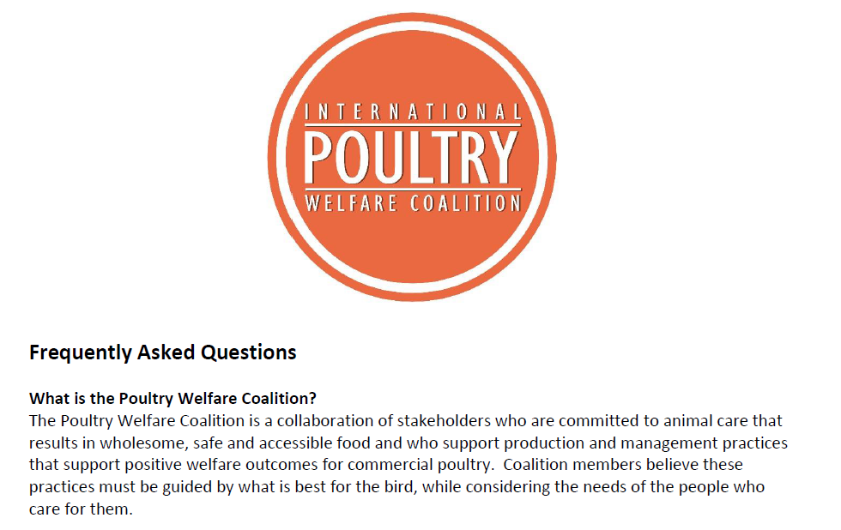

Slide 17
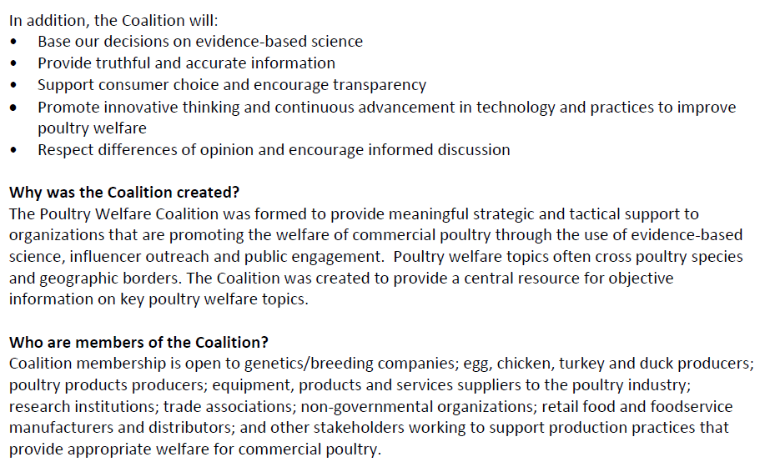

Slide 18
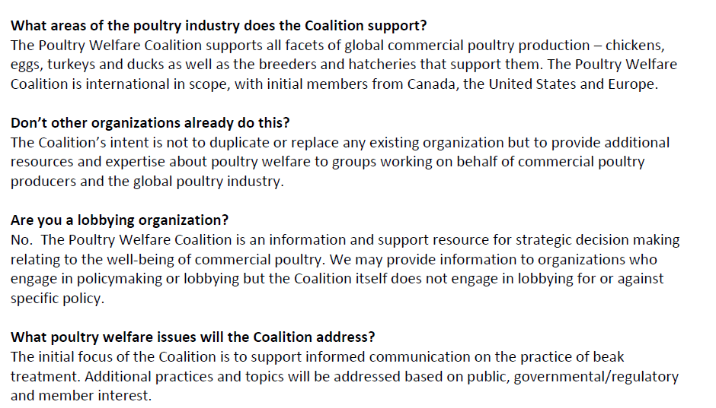

Slide 19
International Poultry Welfare Coalition
https://www.youtube.com/watch?v=qfjGtEG_jFI.

